Slide 1
Luria-Delbrück Experiment: Model Comparison Report
Yoval Koren & Bar Cohen
3.4.2025 Evolution through programming

Slide 2
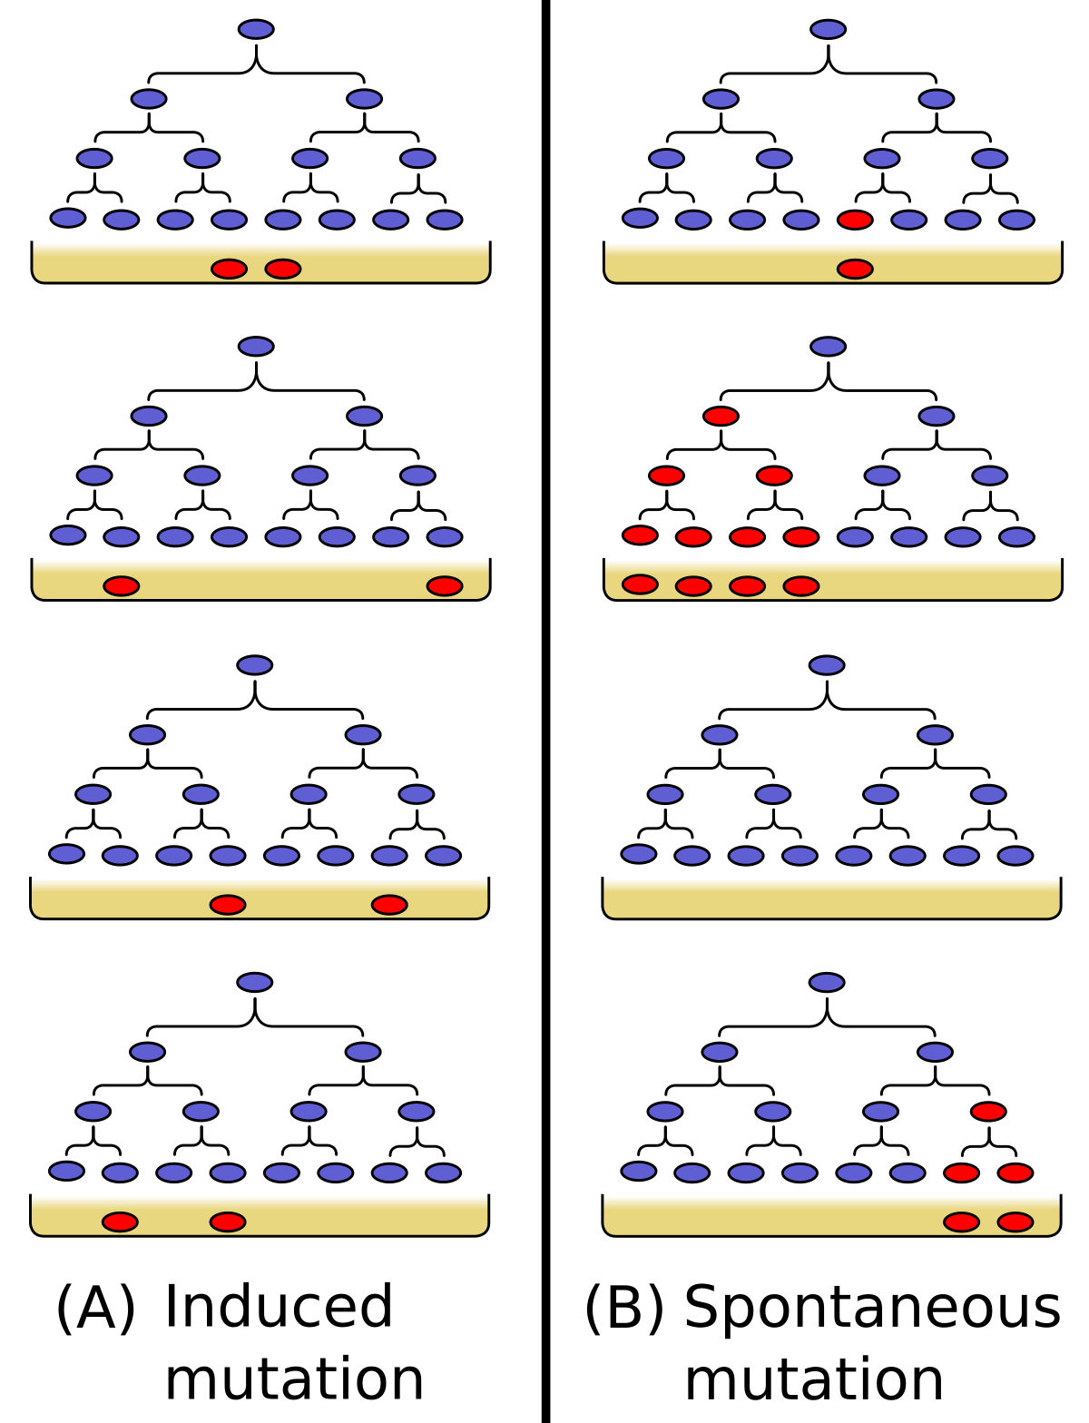
Theoretical assumption
Two competing hypotheses:
Darwinian (Random) Mutation: Mutations occur spontaneously during bacterial growth, independent of selective pressure
Lamarckian (Induced) Mutation: Mutations arise as a direct response to selective pressure

Slide 3
Mathematical implications
Random model: Variance > Mean (Variance-to-Mean Ratio > 1)
Highly skewed, heavy-tailed distribution
Some cultures have extremely high numbers of mutants
Induced model: Variance ≈ Mean (Variance-to-Mean Ratio ≈ 1)

Slide 4
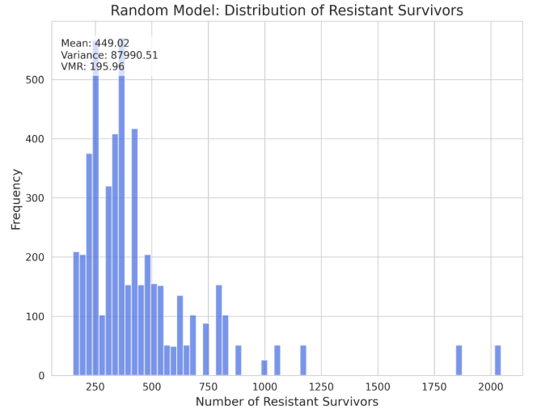
Random Mutation result in heavy-tail distribution

Slide 5
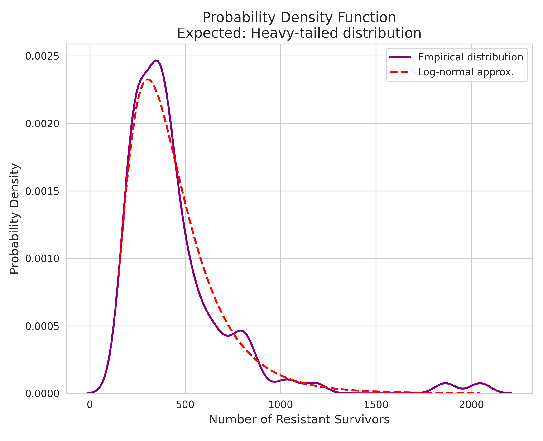
Random Mutation result in heavy-tail distribution

Slide 6
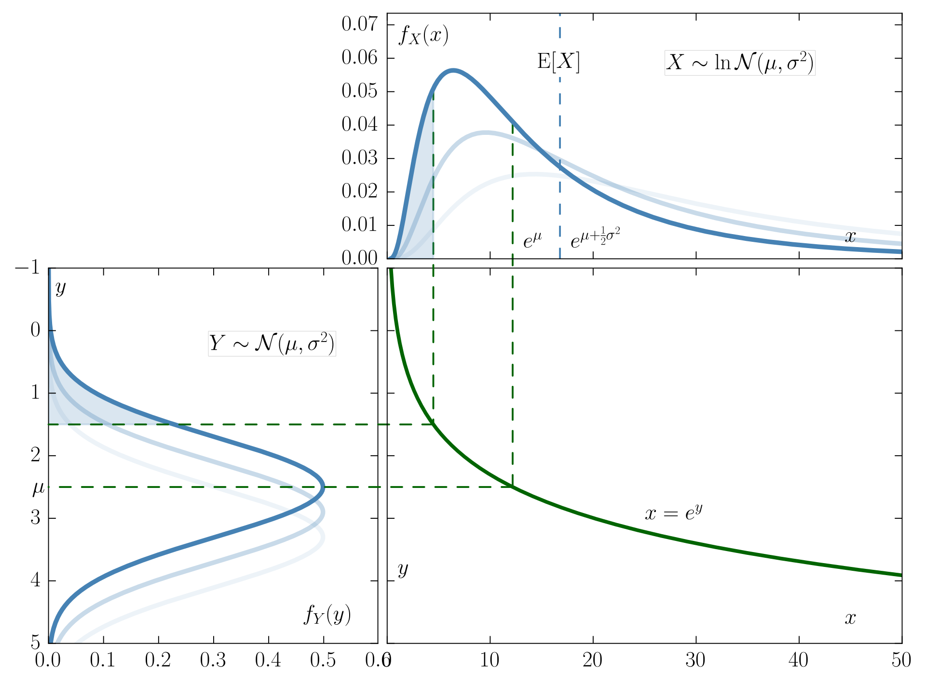
The Log-Normal distribution
The probability dist. of a random variable whose logarithm is normally distributed

Slide 7
The Log-Normal distribution – why? An intuition
Random variable whose logarithm is normally distributed
Why?
Most of mutant bacteria in the last generation are from the first mutation
(If we have mutation in gen. 3 and in gen. 7, we can neglect gen. 7 offsprings)
How does the generation of first mutation distribute?
Binomial!
~Normal!
So last generation has ~2^k mutants, with k normally distributed
Log-normal ☺

Slide 8
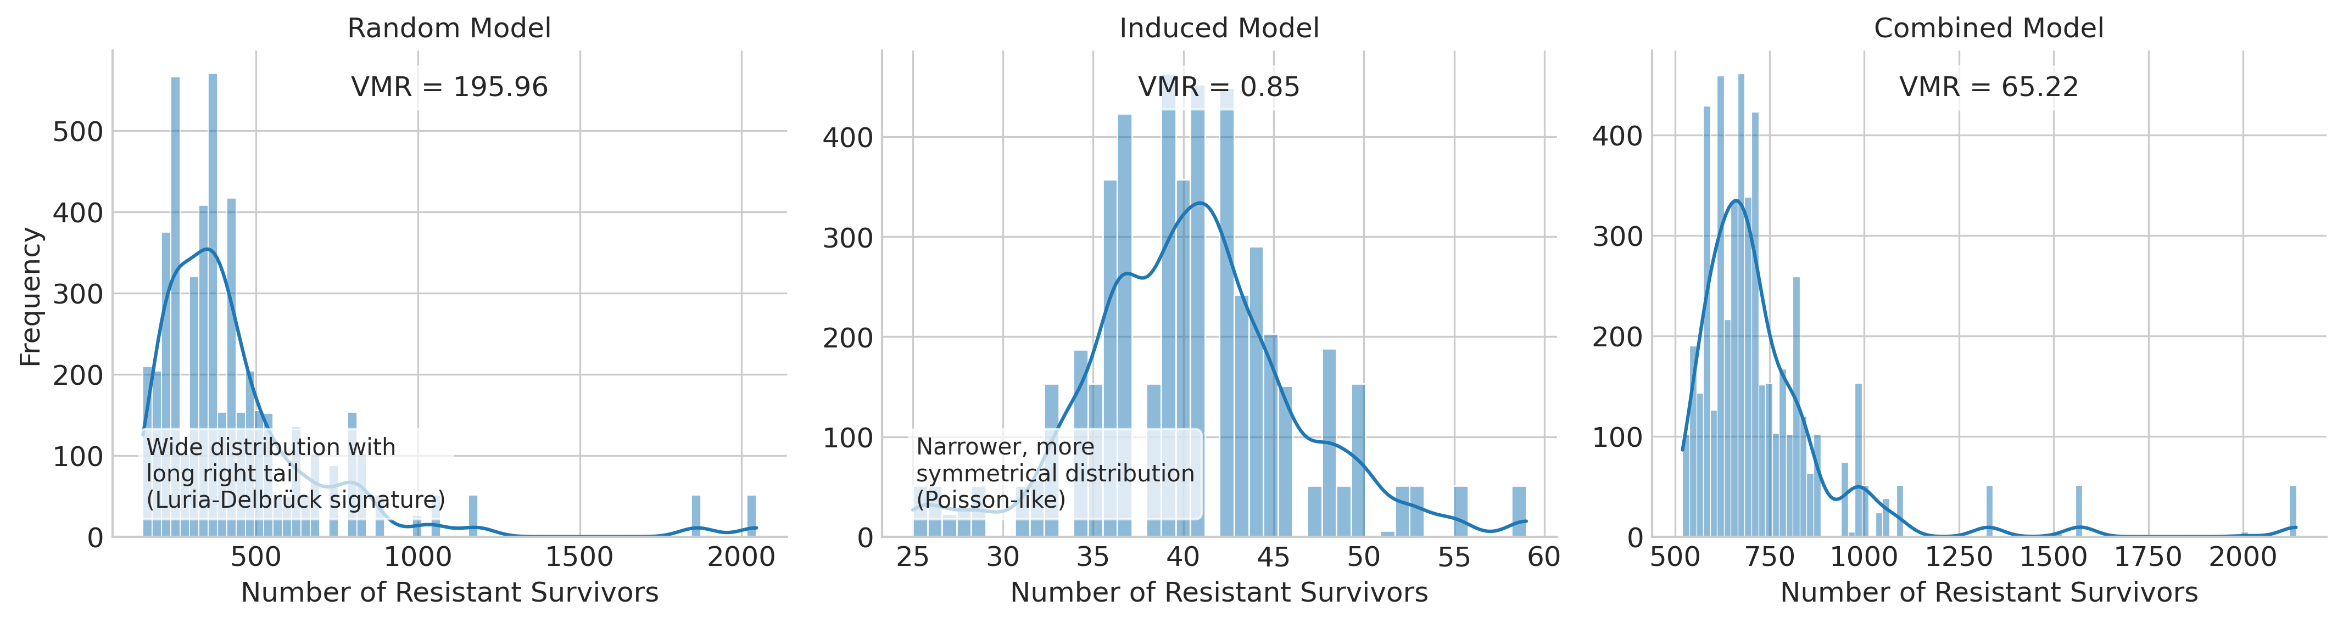
Random , Induced and Combined model presenting different types of distributions

Slide 9
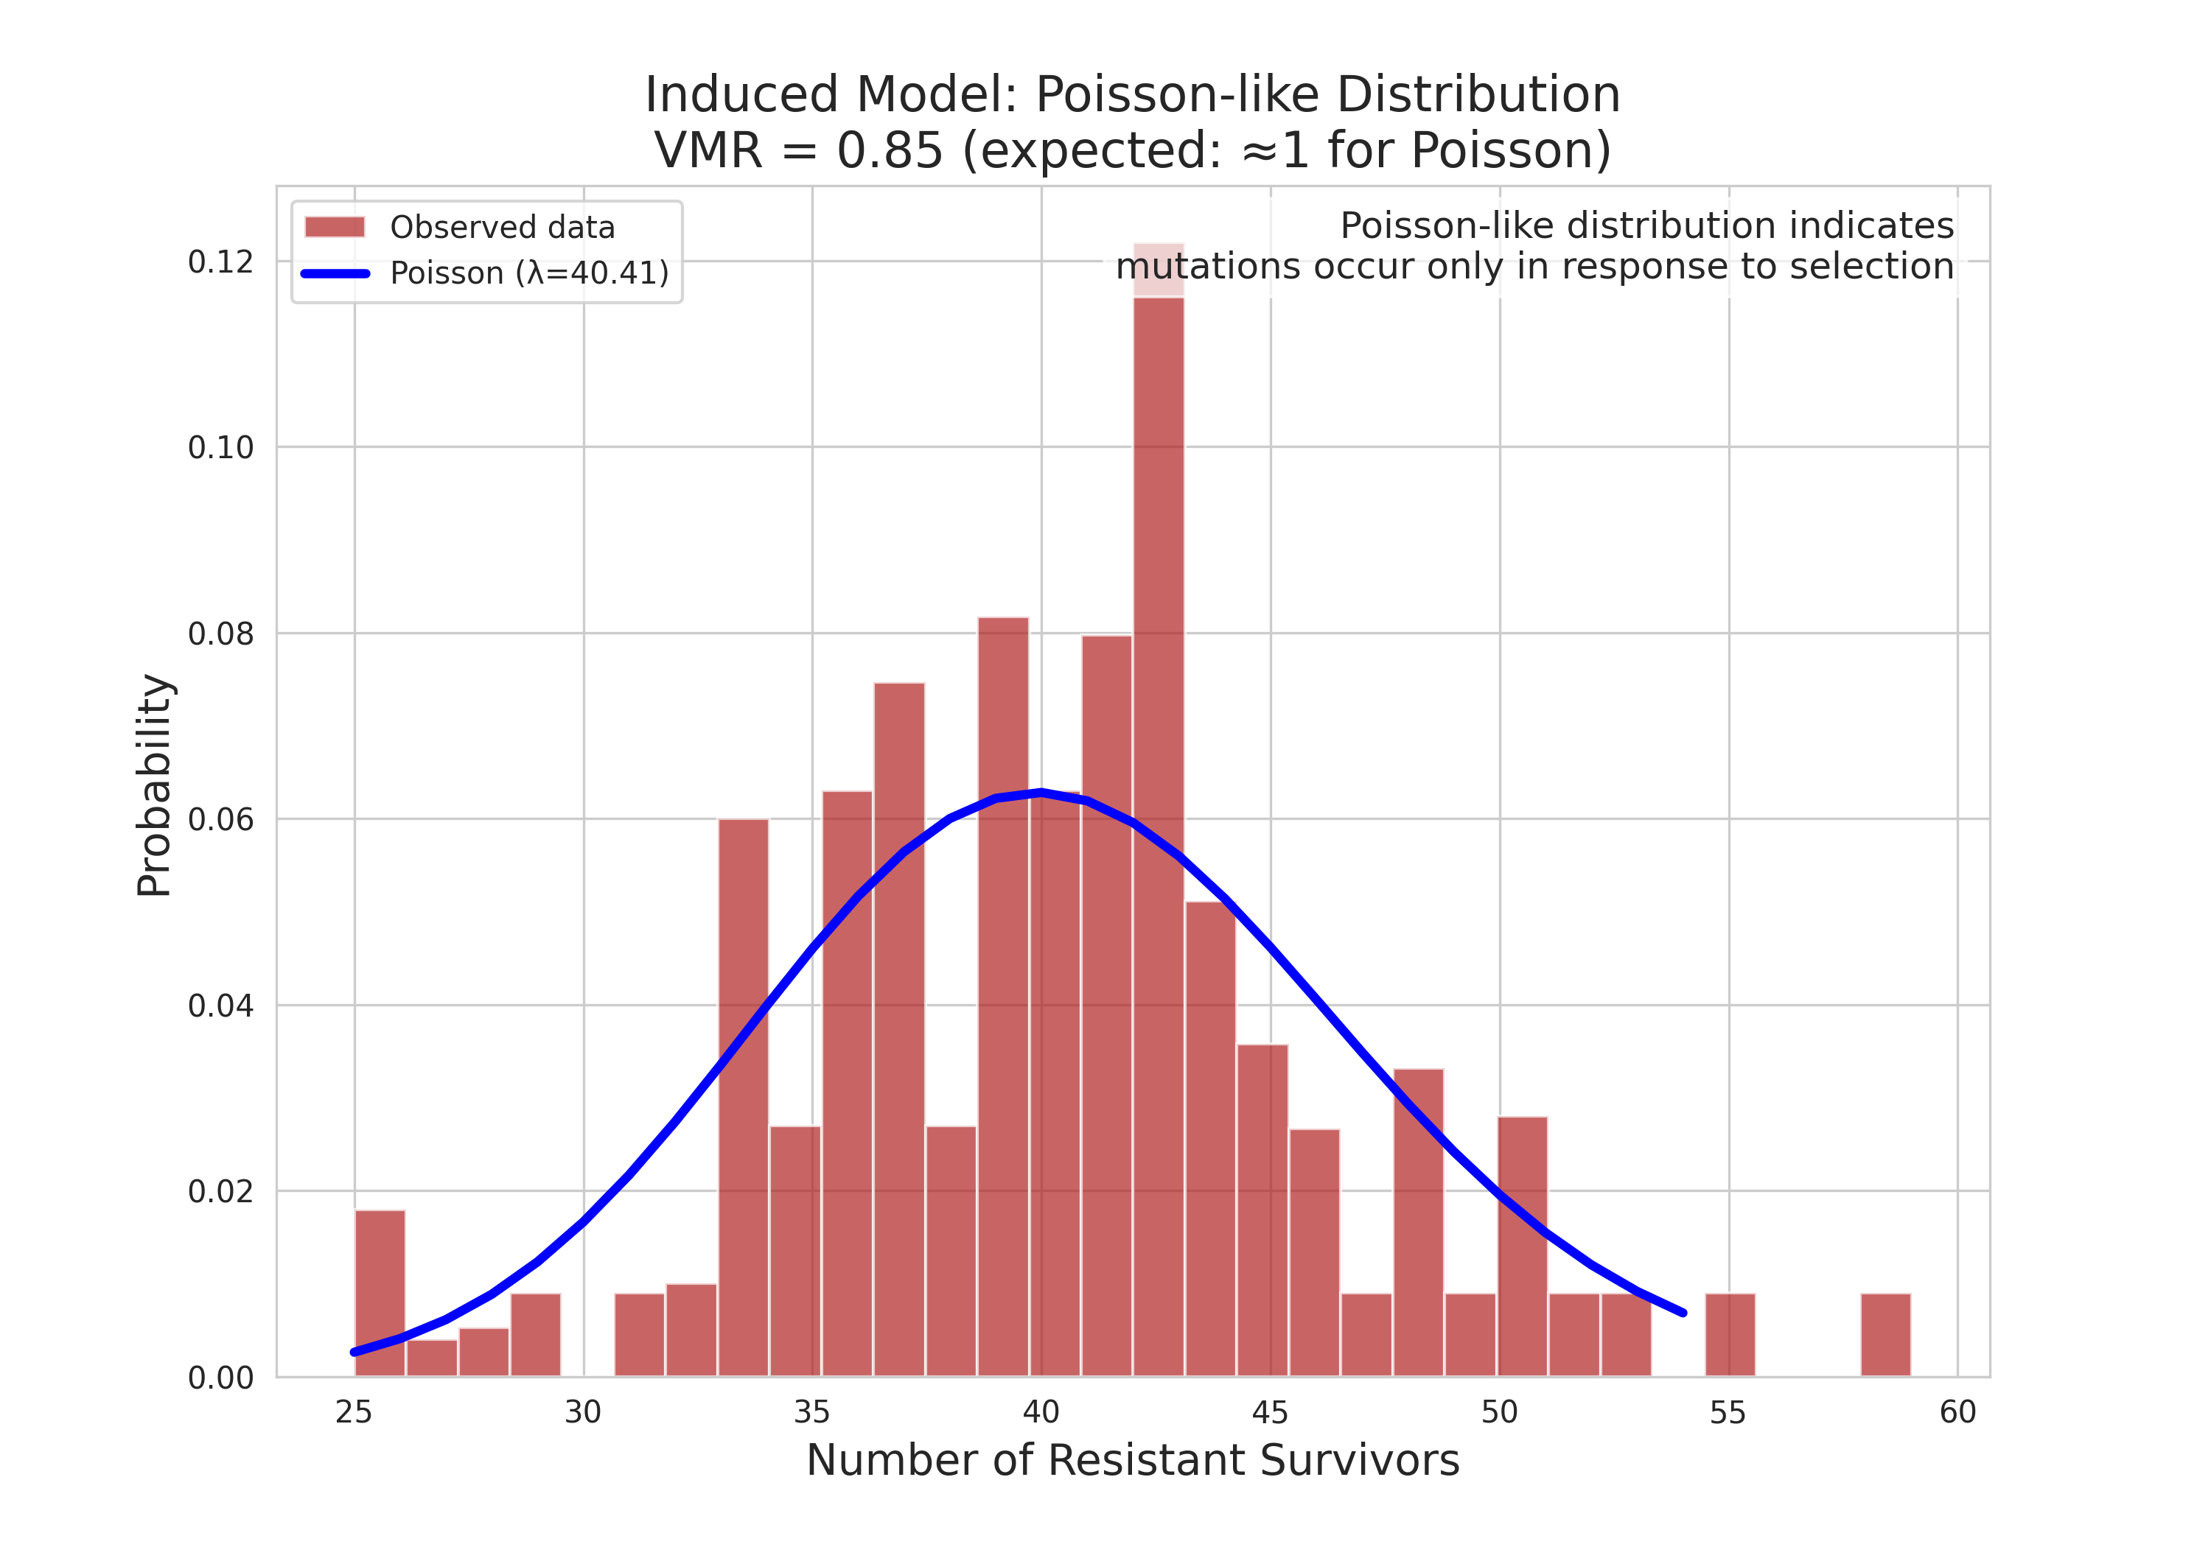
Induced Mutation – Poisson distribution

Slide 10
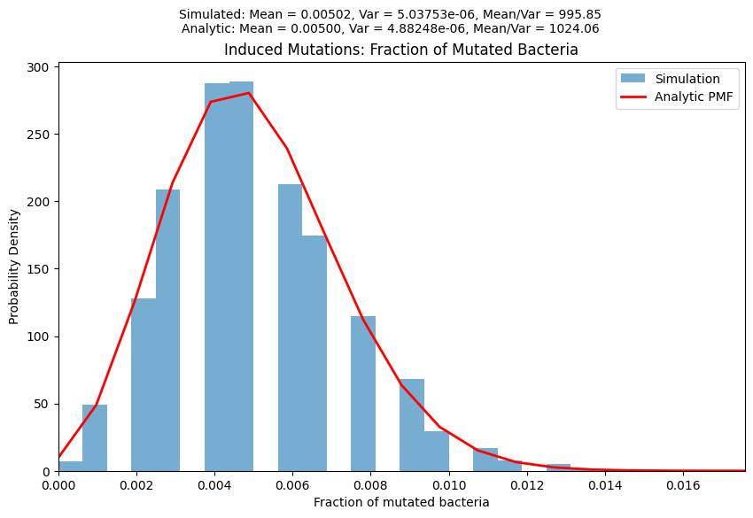
Induced Mutation – Poisson distribution

Slide 11
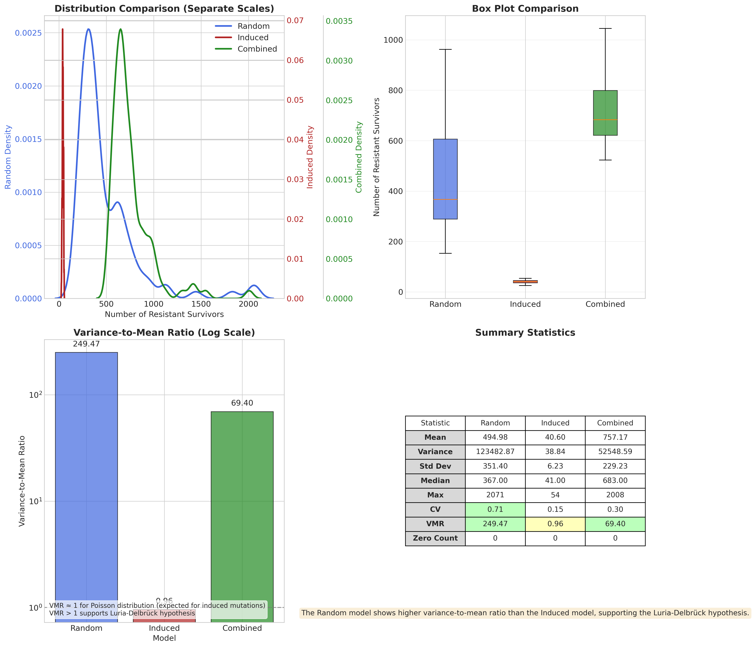
Variance/ mean ratio helps to distinguish between models

Slide 12
Questions?

